Slide 1
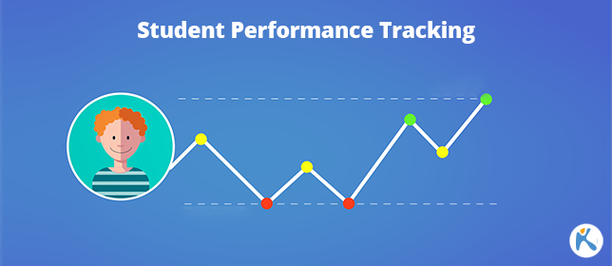


Student Performance Prediction
Presented by Rachana Maji
A predictive model to estimate students’ final grades based on demographic, social & academic factors.

Slide 2



Description
Key Features :
Data collection and preprocessing (handling missing data, normalization).
Exploratory data analysis (EDA) using Matplotlib and Seaborn.
Feature selection and correlation analysis.
Model building using Scikit-learn algorithms (Logistic Regression, Random Forest, etc.).
Model evaluation using accuracy, precision, recall, and F1-score.
Visualization of results and performance trends.
Objectives :
To build a predictive model that forecasts student academic performance.
To analyze how various factors affect learning outcomes.
To provide insights that can help improve teaching methods and student engagement.
Technologies Used :
IDE: Visual Studio Code
Language: Python
Libraries: Pandas, NumPy, Seaborn, Scikit-learn, Streamlit

Slide 3
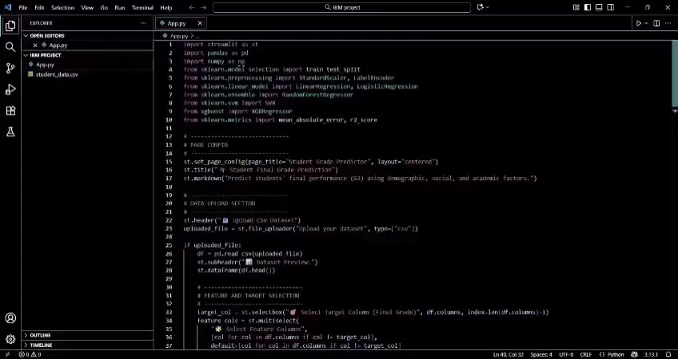
Demo Video of Working Model
Here is the demo video of the front-end interface of my Student Performance Prediction

Slide 4
Tech Stack
Machine Learning
Frontend
1. Python - Core programming language used.
2. Pandas - For data loading, cleaning, and manipulation (pd. read_csv, .head(), etc.).
3. NumPy - For numerical computations and array operations.
4. Scikit-learn (sklearn) - For building and evaluating ML models:
• train_test_split - splitting dataset
• StandardScaler - data normalization
• LabelEncoder - encoding categorical variables
1. Streamlit - For creating the interactive web app UI:
• File upload interface (st. file_uploader)
• Model and feature selection (st. selectbox, st.multiselect)
Displaying dataset and metrics (st. dataframe, st.write, st.success)
• Real-time prediction inputs (st. number_input, st.selectbox)
Page layout and configuration (st.set_page_config, headers, markdowns, emojis)
Session Management
Streamlit Session State (st. session_state) - To store trained model, scaler, and encoders for reusing them during prediction without retraining.
Models:
LinearRegression
LogisticRegression
RandomForestRegressor
SVR (Support Vector Regressor)
• Evaluation metrics:
mean_absolute_error
r2_score
5. XGBoost (xgboost) - For gradient boosting model (XGBRegressor), improving accuracy and performance.
Visualization (Basic Display)
Streamlit DataFrame Viewer - Used to preview uploaded datasets and show model metrics (no external plotting library like matplotlib or seaborn used).

Slide 5
Algorithms Used
Linear Regression
Random Forest Regression
Type: Supervised Learning (Regression)
Purpose: Predicts continuous numeric values (e.g., final grades).
Equation-based model using least squares method.
Type: Ensemble Learning (Regression)
Purpose: Predicts using a collection of decision trees.
Improves accuracy and reduces overfitting by averaging multiple trees.
Support Vector Regressor (SVR)
Type: Supervised Learning (Regression)
Purpose: Fits data within a margin using kernel functions.
Works well for non-linear relationships.
Logistic Regression
XGBoost Regressor
Type: Supervised Learning (Classification)
Purpose: Used if the target variable is categorical (e.g., pass/fail).
Uses sigmoid function to estimate probabilities.
Type: Ensemble Learning (Boosting Technique)
Purpose: Uses gradient boosting framework for high performance and speed.
Builds trees sequentially, optimizing errors from previous trees.

Slide 6
Reason for choosing this project
To understand how data science and machine learning can be applied in the field of education.
2. To analyze the factors that influence students’ academic performance.
3. To help identify students who may need extra academic support early.
4. To gain practical experience in Python programming and using tools like VS Code.
5. To enhance knowledge of data preprocessing, visualization, and predictive modeling.
6. To contribute to improving the overall teaching and learning process through data-driven insights.
7. To work on a real-world problem that is relatable and meaningful as a student.

Slide 7

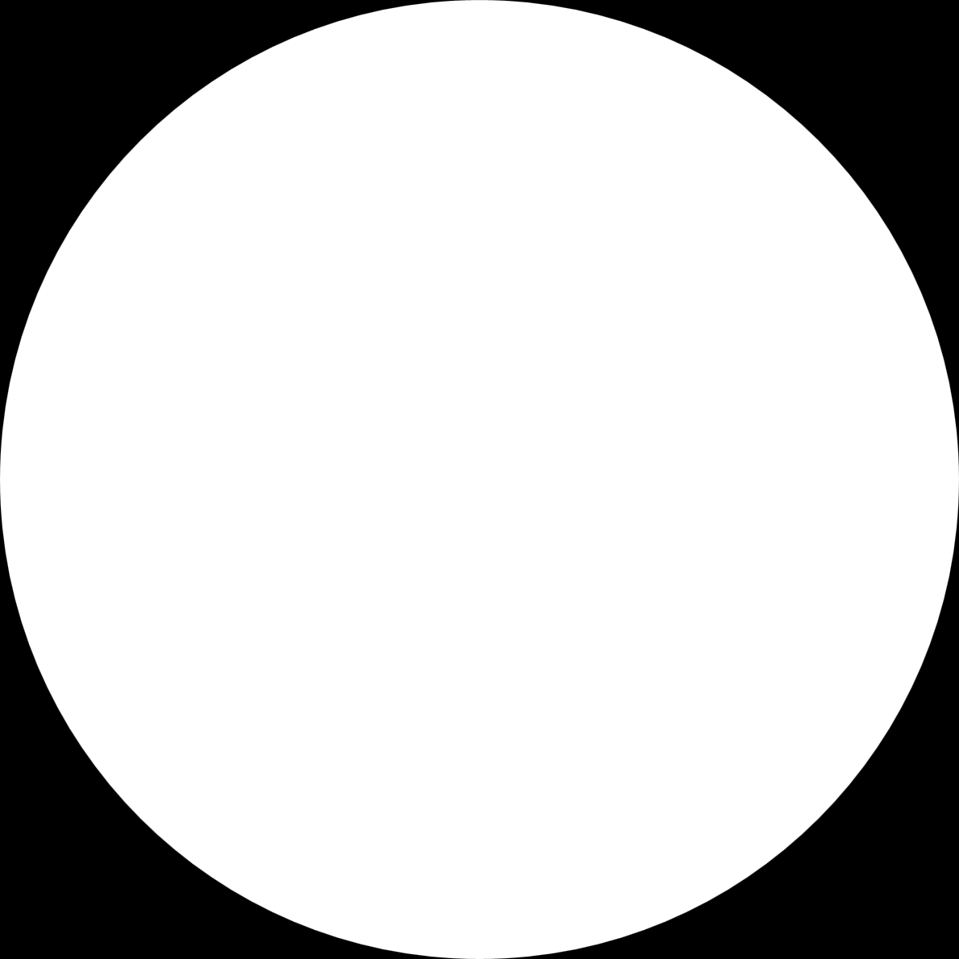
What I’m Trying To Solve
Many students struggle academically due to various factors like poor study habits, irregular attendance, or lack of family support. Teachers often find it difficult to detect these issues in advance.
Your Student Performance Prediction System uses Machine Learning to analyze demographic, social, and academic data and predict the final grade (G3). This helps educators to:
Identify at-risk students early who may fail or underperform.
Provide targeted support and intervention (like counseling, extra classes, or mentoring).
Understand key factors influencing student performance (like study time, health, or prior grades).
Make data-driven academic decisions instead of relying only on observation.

Slide 8
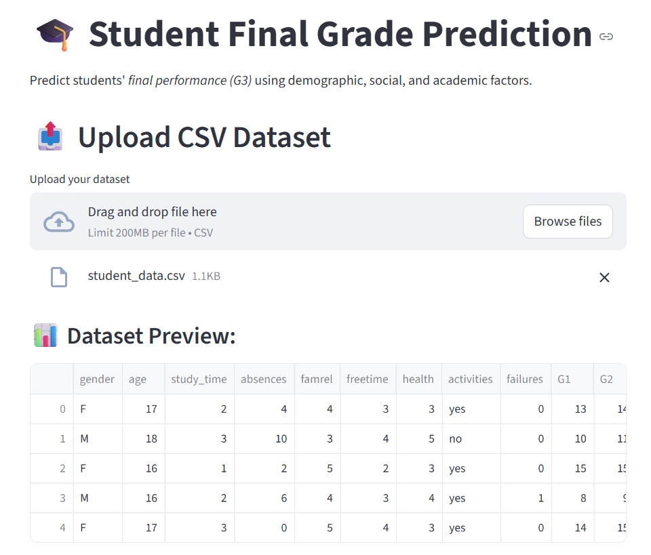
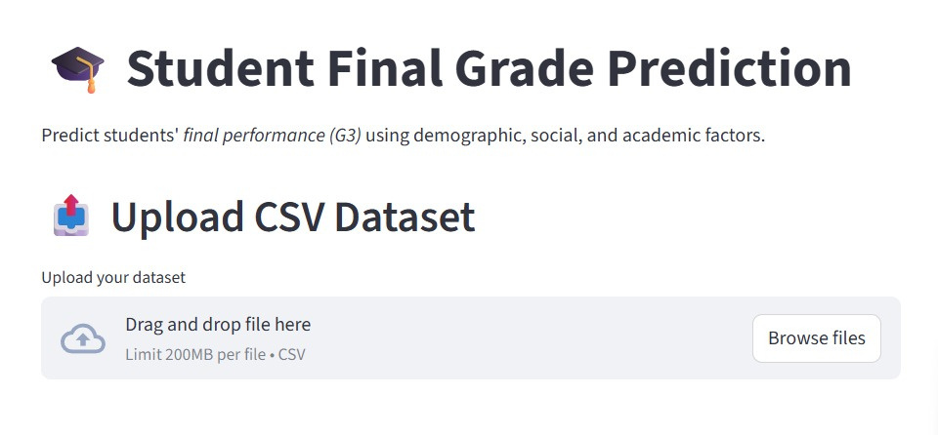
Demo Interface Screenshots

Slide 9
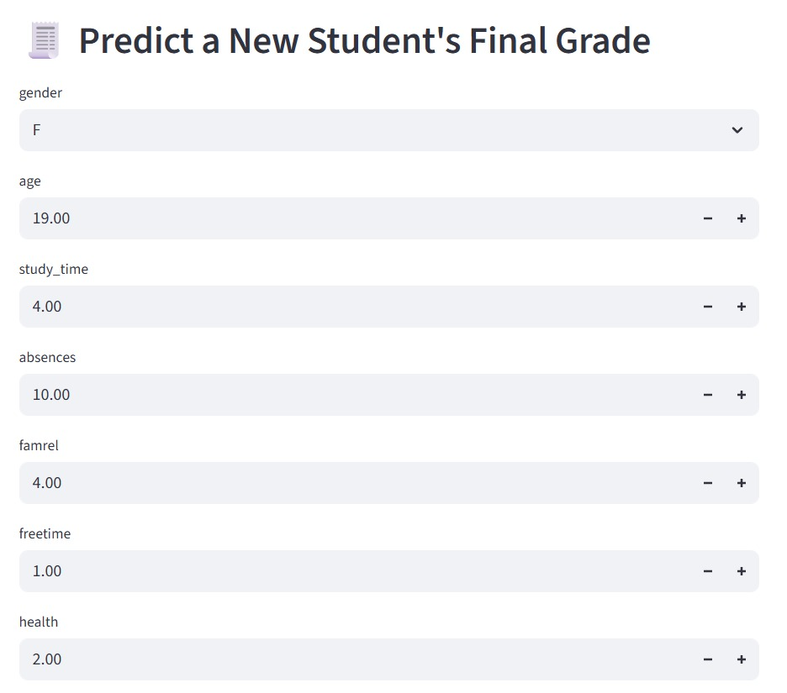
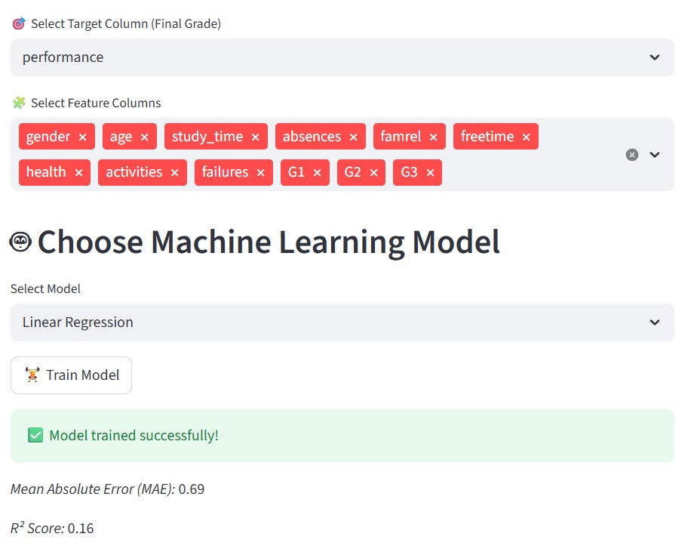
Demo Interface Screenshots

Slide 10
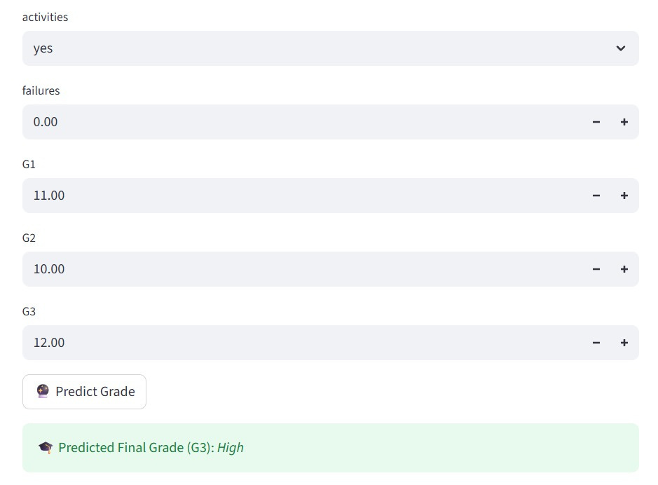
Demo Interface Screenshots

